Slide 1
Sample
Slides
Email errors and corrections to safa.kasap@yahoo.com

Slide 2
ISBN-13: 978-0078028182
ISBN-10: 0078028183

Slide 3
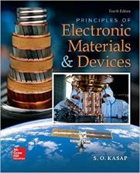

Copyright Information and Permission Part I
This Power Point presentation is a copyrighted supplemental material to the textbook Principles of Electronic Materials and Devices, Fourth Edition, S. O. Kasap, McGraw-Hill Education (USA), ISBN-13: 978-0078028182, ISBN-10: 0078028183 © 2018 McGraw-Hill Education. Permission is given to instructors to use these Power Point slides in their lectures provided that the above book has been adopted as a primary required textbook for the course. Slides may be used in research seminars at research meetings, symposia and conferences provided that the author, book title, and copyright information are clearly displayed under each figure. It is unlawful to use the slides for teaching if the textbook is not a required primary book for the course. The slides cannot be distributed in any form whatsoever, especially on the internet, without the written permission of McGraw-Hill Education.
Please report typos and errors directly to the author: safa.kasap@yahoo.com

Slide 4
Copyright Information and Permission: Part II
This Power Point presentation is a copyrighted supplemental material to the textbook Principles of Electronic Materials and Devices, Fourth Edition, S. O. Kasap, McGraw-Hill Education (USA), ISBN-13: 978-0078028182, ISBN-10: 0078028183 © 2018 McGraw-Hill Education. Slides may be used in research seminars at research meetings, symposia and conferences provided that the author, book title, and copyright information are clearly displayed under each figure. It is unlawful to use the slides for teaching if the textbook is not a required primary book for the course. The slides cannot be distributed in any form whatsoever, especially on the internet, without the written permission of McGraw-Hill Education. It is unlawful to post these slides, or part of a slide or slides, on the internet.
Copyright © 2018, 2006, 2002, 2000, 1997 by McGraw-Hill Education, 2 Penn Plaza, New York, NY 10121, USA. All rights reserved. This publication is protected by Copyright and permission should be obtained from the publisher prior to any prohibited reproduction, storage in a retrieval system, or transmission in any form or by any means, electronic, mechanical, photocopying, recording, or likewise. For information regarding permission(s), write to: Rights and Permissions Department, McGraw-Hill Education, 2 Penn Plaza, New York, NY 10121, USA. (https://www.mheducation.com/permissions.html)

Slide 5
Important Note
You may use color illustrations from this Power Point in your research-related seminars or research-related presentations at scientific or technical meetings, symposia or conferences provided that you fully cite the following reference under each figure
From: S.O. Kasap, Principles of Electronic Materials and Devices, Fourth Edition, © 2018 McGraw-Hill Education
THIRD PARTY PHOTOS AND ARTWORK
All third party images such as photos and artwork have been used with full permission and, in most case, copyright fees have been paid. If you wish to extract and use these images in other Power Points or any other work, you need to contact the original copyright holder.
Report errors and corrections directly to the author at
safa.kasap@yahoo.com

Slide 6
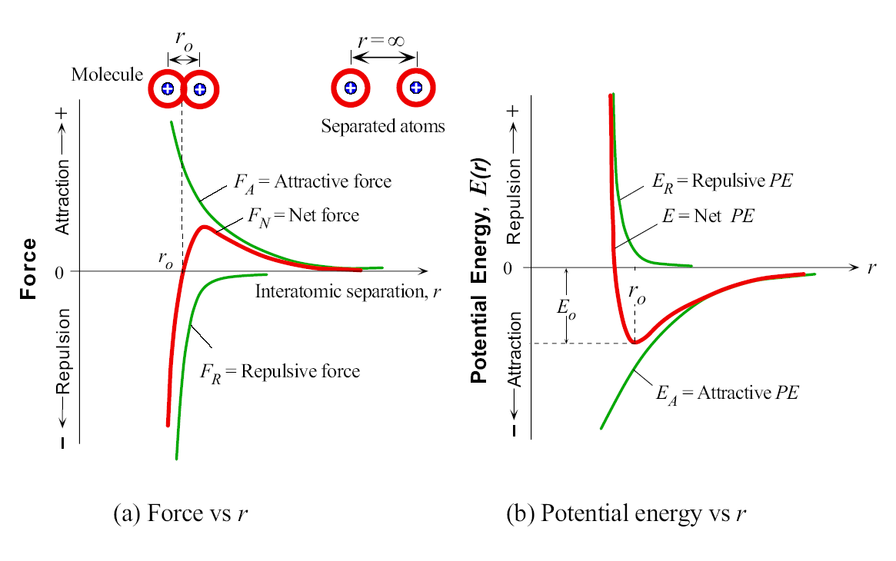
Bonding Between Atoms
(a) Force vs. interatomic separation (b) Energy vs. interatomic separation

Slide 7
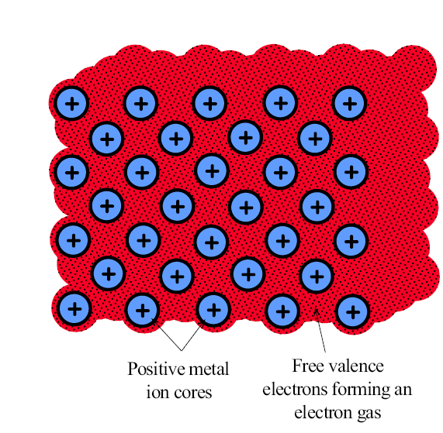
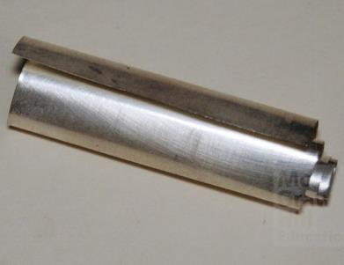
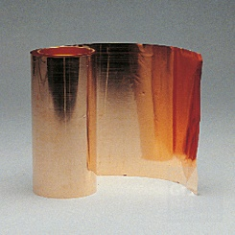
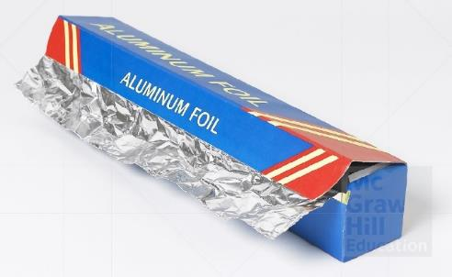
Metallic Bonding
The free electrons inside a metal can drift under the action of the applied field and give rise to a current. These free electrons in the metallic bond are called conduction electrons.
Metals are good electrical conductors
Metals are also good thermal conductors
Silver
© McGraw-Hill Education/Mark Dierker
(mhhe022468.jpg)
Copper
© McGraw-Hill Education/Stephen Frisch
(MHHE005312.JPG)
Aluminum (98.5%)
© McGraw-Hill Education/Ken Cavanagh (MHED9000878.JPG)

Slide 8
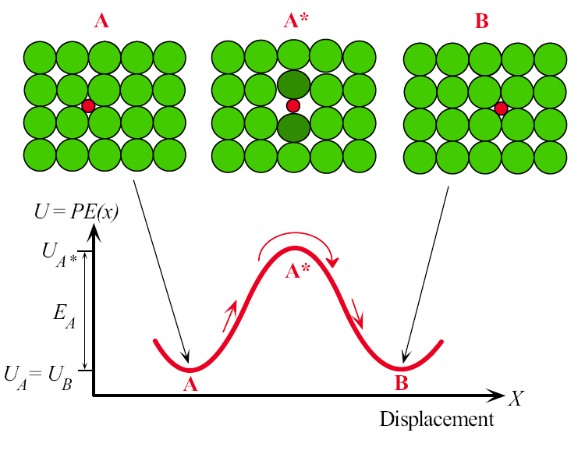
Thermally Activated Processes: Diffusion
Diffusion of an interstitial impurity atom in a crystal from one void to a neighboring void. The impurity atom at position A must posses an energy E_{A} to push the host atoms away and move into the neighboring void at B.

Slide 9
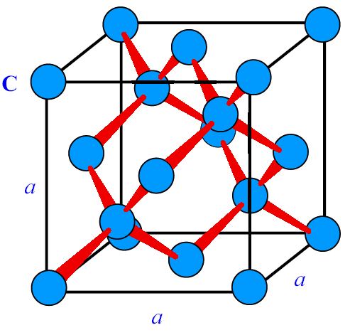
Diamond Unit Cell
The diamond unit cell is cubic. The cell has eight atoms. Grey Sn (α-Sn) and the
Elemental semiconductors Ge and Si have this crystal structure.

Slide 10
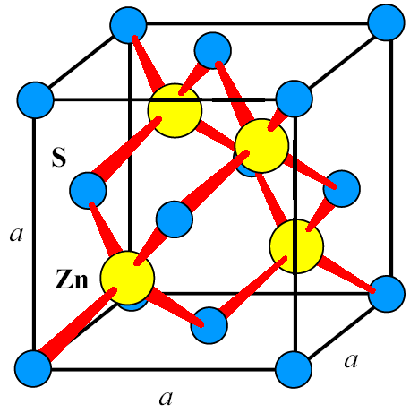
Zinc Blende Cubic Crystal Structure
The Zinc blende (ZnS) cubic crystal structure. Many important compound crystal
Structures have the zinc blende structure. Examples: AlAs, GaAs, Gap, GaSb, InAs, InP,
InSb, ZnS, ZnTe.

Slide 11
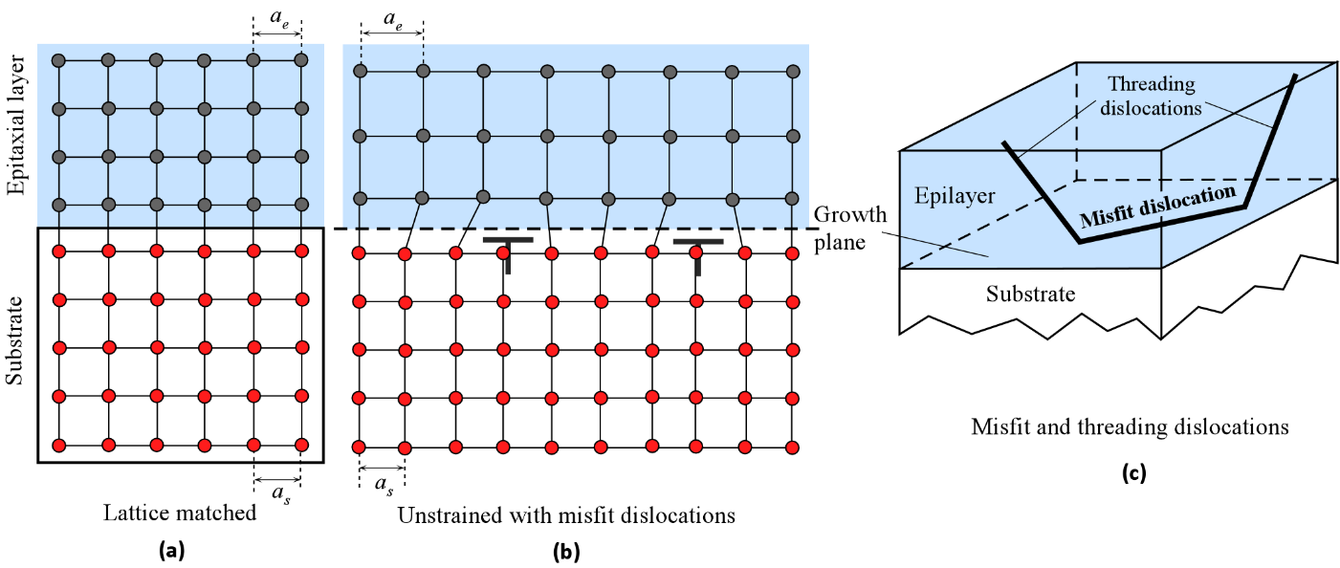
Misfit and Threading Dislocations
(a) The epitaxial layer crystal has the same lattice constant (a_{e}) as the substrate (a_{s}). The crystals are matched and there are no defects at the interface. (b) The epitaxial layer has a larger lattice constant than the substrate, a_{e} > a_{s}, and misfit dislocations are created; otherwise, the epitaxial layer becomes highly strained. The example here may be a Si substrate on which Si_{1−x}Ge_{x} alloy is grown or a GaAs substrate on which an In_{x}Ga_{1−x}As epilayer is grown.
From Principles of Electronic Materials and Devices, Fourth Edition, S.O. Kasap (© McGraw-Hill Education, 2018)

Slide 12
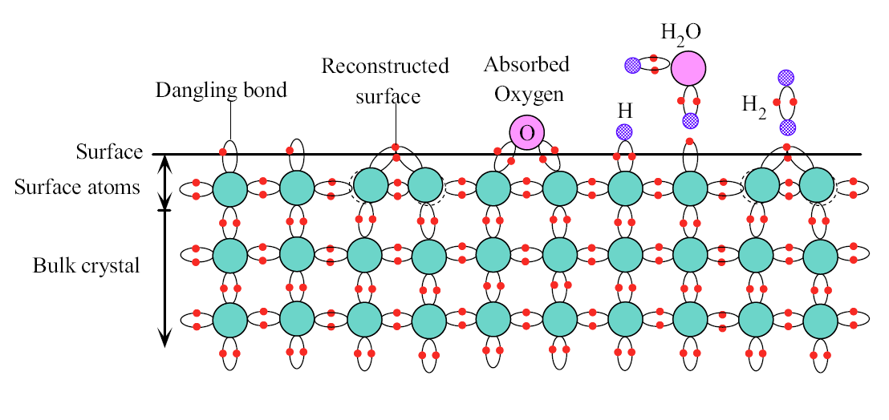
Surfaces of Solids
At the surface of a hypothetical two dimensional crystal, the atoms cannot fulfill their
bonding requirements and therefore have broken, or dangling, bonds. Some of the surface
atoms bond with each other; the surface becomes reconstructed. The surface can have
physisorbed and chemisorbed atoms.

Slide 13
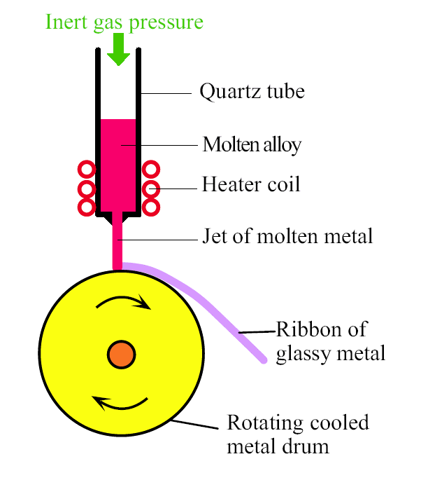
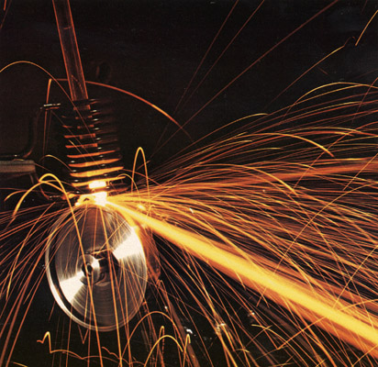
Metallic Glasses (or Glassy Metals) by Melt Spinning
Melt spinning involves squirting a jet of molten metal onto a rotating cool metal drum. The molten jet is instantly solidified into a glassy metal ribbon which is a few microns in thickness. The process produces roughly 1–2 km of ribbon per minute.
Photo courtesy of the Estate of Fritz Goro (Goreau).
It is possible to rapidly quench a molten metallic alloy, thereby bypassing crystallization, and forming a glassy metal commonly called a metallic glass. The process is called melt spinning.

Slide 14
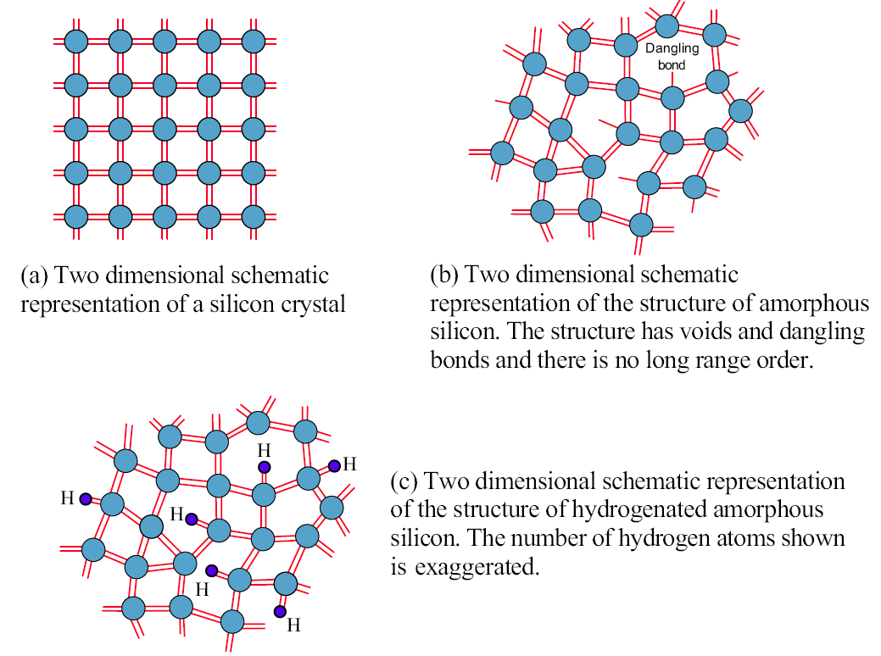
Amorphous Silicon
Silicon can be grown as a semiconductor crystal or as an amorphous semiconductor film.
Each line represents an electron in a band. A full covalent bond has two lines, and a
broken bond has one line.

Slide 15
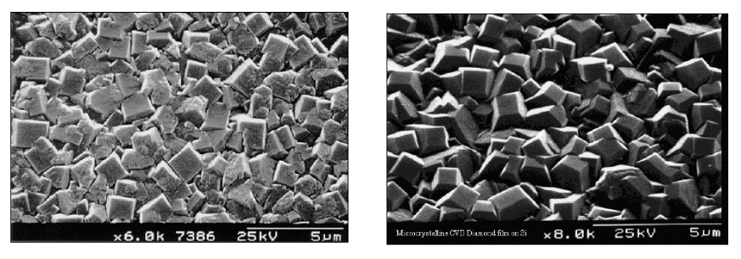
Thin Films of Polycrystalline Diamond
Left: A polycrystalline diamond film on the (100) surface of a single crystal silicon wafer where the growth chemistry has been changed to produce predominantly square-faceted (100) diamond crystallites. The film thickness is 6 microns and the SEM magnification is 6000.
Right: A 6-micron-thick polycrystalline CVD diamond film grown on a single crystal silicon wafer where the crystallites have random orientation. SEM magnification is 8000.
(Courtesy of Professor Paul May, The School of Chemistry, University of Bristol, England. Used with permission.)

Slide 16
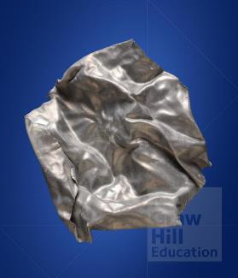
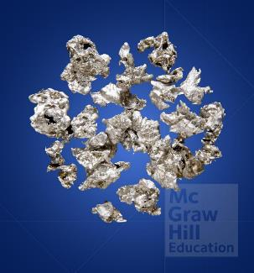
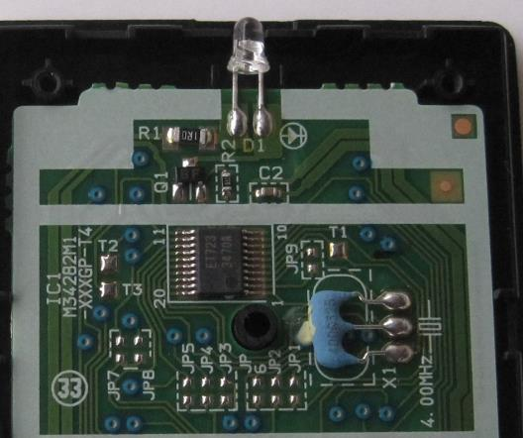
Pb-Sn Binary Alloys: Solders
Pb (lead)
FCC
a = 0.495 nm
T_{m} = 327.5 °C
Winters© McGraw-Hill Education/Charles D. Winters
Sn (Tin)
Tetragonal
a = b = 0.583 nm
c = 0.318 nm
T_{m} = 231.9 °C
© McGraw-Hill Education/Charles D. Winters
60-40 Solder
T_{m} = 183 – 188 °C
Solder
Photo by S. Kasap

Slide 17
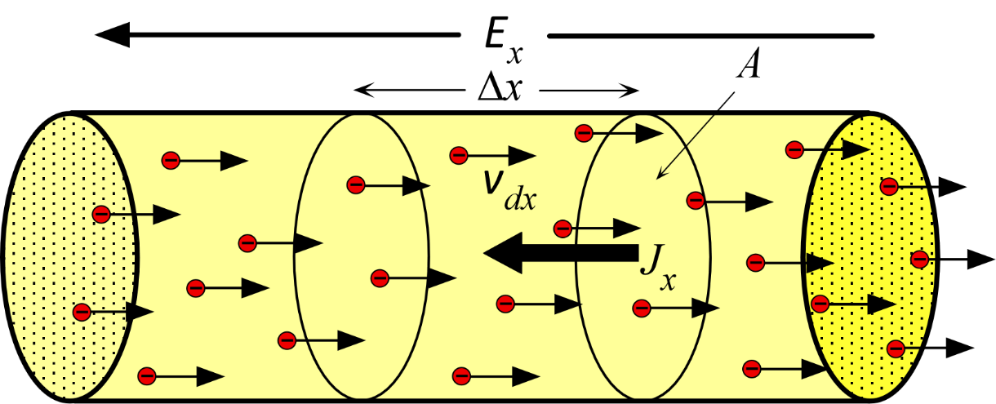
The Drude Model
Paul Drude (1863–1906)
Courtesy of AIP Emilio Segrè Visual Archives, Physics Today Collection.
Drift of electrons in a conductor in the presence of an applied electric field. Electrons drift with an average velocity v_{dx} in the x-direction. (E_{x} is the electric field.)

Slide 18
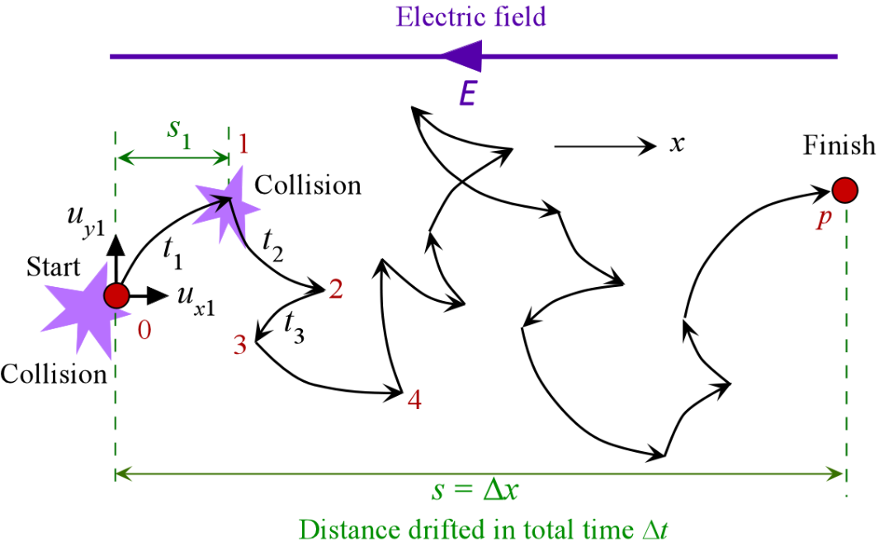
Drift of one electron in a field
The motion of a single electron in the presence of an electric field E. During a time
Interval t_{i}, the electron traverses a distance s_{i} along x. After p collisions, it has drifted a
Distance s = x.

Slide 19
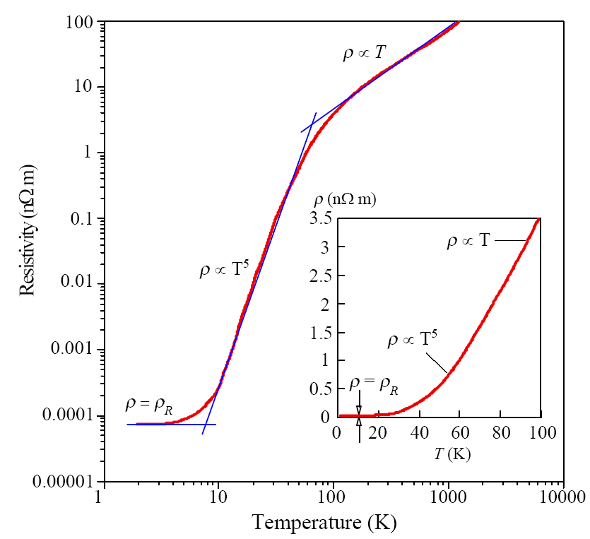
Resistivity vs Temperature
The resistivity of copper from lowest to highest temperatures (near melting temperature, 1358 K) on a log-log plot. Above about 100 K,   T, whereas at low temperatures,  T ⁵ and at the lowest temperatures  approaches the residual resistivity _{R}. The inset shows the  vs. T behavior below 100 K on a linear plot (_{R} is too small on this scale).

Slide 20
Temperature Coefficient of Resistivity Depends on the Reference Temperature
ρ at T = T₀
Gradient at T = T₀
Use ρ at 293 K in CRC Handbook
Use ρ at 273 K in CRC Handbook
Use 293 K
Use 273 K

Slide 21
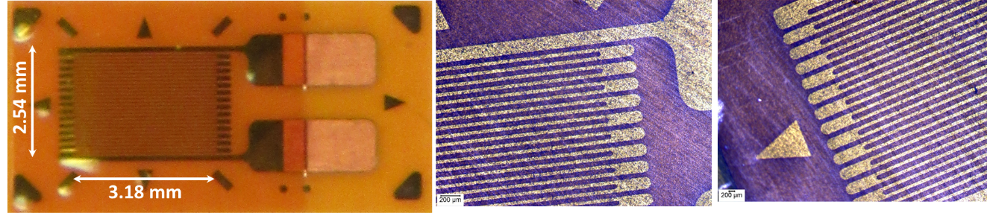
Strain Gauges
A commercial strain gauge by Micro- Measurements (Vishay Precision Group). This gauge has a maximum strain range of ±5%. The overall resistance of the gauge is 350 Ω. The gauge wire is a constantan alloy with a small thermal coefficient of resistance. The gauge wires are embedded in a polyimide polymer flexible substrate. The external solder pads are copper coated. Its useful temperature range is –75 °C to +175 °C. (Photo by S. Kasap)

Slide 22
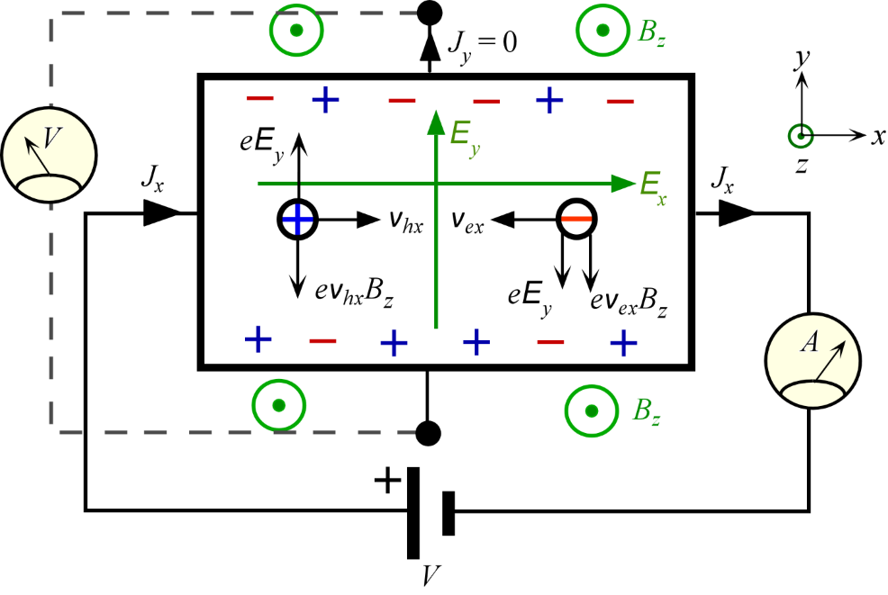
Hall Effect in Semiconductors
Hall effect for ambipolar conduction as in a semiconductor where there
are both electrons and holes. The magnetic field B_{z} is out from the plane of the paper. Both electrons and holes are deflected toward the bottom surface of the conductor and consequently the Hall voltage depends on the relative mobilities and concentrations of electrons and holes.

Slide 23
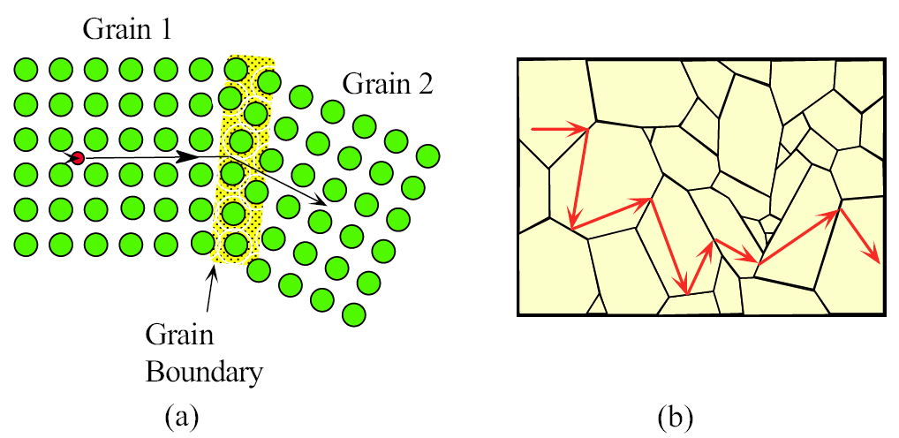
Resistivity of Thin Films
TEM (transmission electron microscope) image of an annealed polycrystalline Cu thin film of thickness 41.7 nm, encapsulated in SiO2. The films structure is composed of grains with an average size 87.7 nm. The resistivity of this film is 30 nΩ m, higher than the bulk resistivity of Cu (17 nΩ m). Courtesy of Tik Sun and Bo Yao.
Grain boundaries cause scattering of the electron and therefore add to the
Resistivity by the Matthiessen’s rule.
(b) For a very grainy solid, the electron is scattered from grain boundary to grain boundary
and the mean free path is approximately equal to the mean grain diameter.

Slide 24
X-rays are photons
X-ray image of an American one-cent coin captured using an x-ray a-Se HARP camera. The first image at the top left is obtained under extremely low exposure and the subsequent images are obtained with increasing exposure of approximately one order of magnitude between each image. The slight attenuation of the X-ray photons by Lincoln provides the image. The image sequence clearly shows the discrete nature of x-rays, and hence their description in terms of photons.
SOURCE: Brian J. M. Lui, D. C. Hunt, A. Reznik, K. Tanioka, and J. A. Rowlands, “X-ray imaging with amorphous selenium: Pulse
height measurements of avalanche gain fluctuations”, Medical Physics, 33, 3183-3192 (2006); Figure 3.

Slide 25
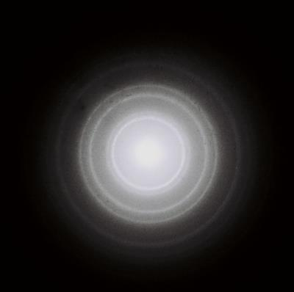
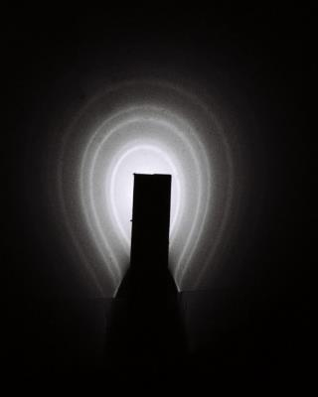
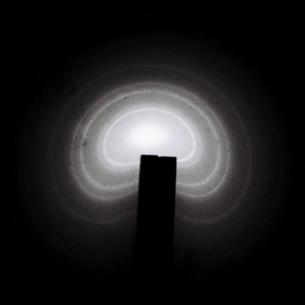
Diffraction of Electrons
Left: Circular bright rings make up the diffraction pattern obtained when an electron beam is passed through a thin polycrystalline aluminum sheet. The pattern results from the wave behavior of the electrons; the waves are diffracted by the Al crystals.
Center and Right: A magnet brought to the screen bends the electron paths and distorts the diffraction pattern. The magnet would have no effect if the pattern was due to X-rays, which are electromagnetic waves. Courtesy of Farley Chicilo
Fig 3.13

Slide 26
Diffraction of Electrons
A comparison of an actual electron diffraction ring pattern from an Al sample (left) with the diffraction pattern that would be obtained from an X-ray beam of wavelength 0.0357 nm (right). The electron kinetic energy was 10 keV, which corresponds to the same wavelength.
(Photo by S. Kasap)
Fig 3.14

Slide 27
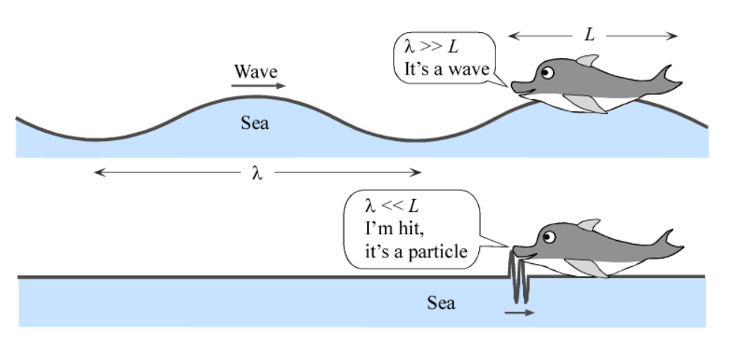
Wave-Particle Duality
Drawing by SK

Slide 28
Magnetic Dipole Moment of the Electron
The orbiting electron is equivalent to a current loop that behaves like a bar magnet.
The spinning electron can be imagined to be equivalent to a current loop as shown.
This current loop behaves like a bar magnet, just as in the orbital case.

Slide 29
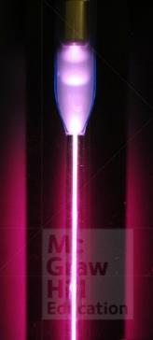
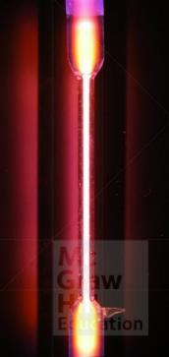
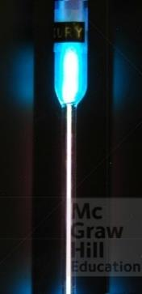
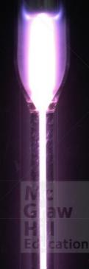
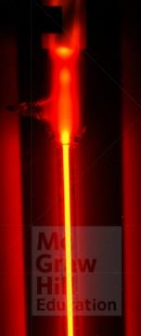
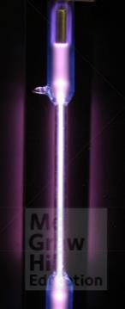
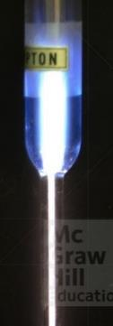
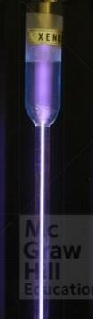
Characteristic emission wavelengths from gas discharge tubes
Note: Emission may appear white due to several wavelengths.
Hydrogen gas
(magenta)
Nitrogen gas
Mercury vapor
(blue)
Helium gas
Neon gas
(red)
Argon gas
(violet/lavender)
Krypton gas
Xenon gas
© McGraw-Hill Education/Mark Dierker

Slide 30
Energy diagram for the Er³⁺ ion in the glass fiber
Energy diagram for the Er³⁺ ion in the glass fiber medium and light amplification by
Stimulated emission from E₂ to E₁.
Dashed arrows indicate radiationless transitions (energy emission by lattice vibrations).
Fig 3.48

Slide 31
Energy band diagram of a semiconductor
Energy band diagram of a semiconductor. CB is the conduction band and VB is the valence
band. AT 0 K, the VB is full with all the valence electrons.
Fig 4.19
From Principles of Electronic Materials and Devices, Fourth Edition, S.O. Kasap (© McGraw-Hill Education, 2018)

Slide 32
Density of States
(a) In the solid there are N atoms and N extended electron wavefunctions from ₁ all the way
to _{N}. There are many wavefunctions, states, that have energies that fall in the central regions
Of the energy band.
(b) The distribution of states in the energy band; darker regions have a higher number of states.
(c) Schematic representation of the density of states g(E) versus energy E.
Fig 4.23
From Principles of Electronic Materials and Devices, Fourth Edition, S.O. Kasap (© McGraw-Hill Education, 2018)

Slide 33
Soft X-Ray Emission
= n_{E}
Emission of soft X-rays from a sodium sample that is bombarded by electrons (in a suitable high vacuum). An impinging electron knocks out an electron from an inner core shell (L-level). A conduction electron falls down and fills this space and emits an X-ray photon. The X-ray emission intensity is proportional to the number of conduction electrons available, f(E)g(E) = n_{E}, and to hf³, a quantum mechanical transition probability. The vertical axis has been scaled to make the peak 100 percent
Data extracted from Cady, W.M. and Tomboulian D.H., Physical Review 59, 381, 1941, Table 1.
Fig 4.30
From Principles of Electronic Materials and Devices, Fourth Edition, S.O. Kasap (© McGraw-Hill Education, 2018)

Slide 34
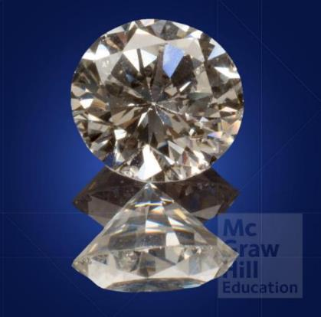
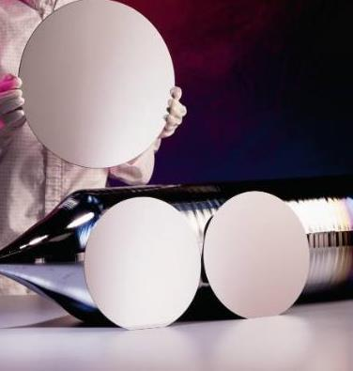

Thermal Conductivity κ
Phonons transfer heat
Phonons transfer heat
Electrons transfer heat
Diamond
Full-length view of two cut diamonds
© McGraw-Hill Education (mhhe017428-S.jpg)
Si crystal and wafers
Courtesy of SunEdison Semiconductor
Silver
© McGraw-Hill Education/Mark Dierker
(mhhe022468.jpg)
 | κ (W K⁻¹ m⁻¹) | Energy transfer by
Diamond (Insulator) | 1000 | Phonons
Silicon (Semiconductor) | 148 | Phonons
Zirconia, ZrO₂ (Insulator) | 2.7 | Phonons
Silver (Metal) | 429 | Electrons
Notice the large variation in κ for insulators
From Principles of Electronic Materials and Devices, Fourth Edition, S.O. Kasap (© McGraw-Hill Education, 2018)

Slide 35
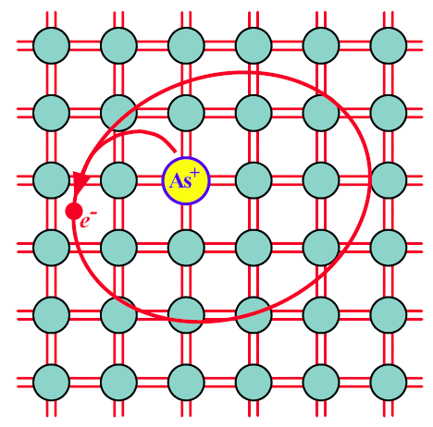
n-Type Silicon
Arsenic-doped Si crystal.
The four valence electrons of As allow it to bond just like Si, but the fifth electron is left
orbiting the As site. The energy required to release the free fifth electron into the CB is
very small.

Slide 36
Direct and Indirect Recombination
(a) The electron energy (E) versus electron’s crystal momentum (ħk) in a direct bandgap semiconductor. Each circle represents a possible state, an electron wavefunction (ψ), a solution of Schrodinger’s equation in a crystal, with a wave vector k. These solutions fall either into the CB or the VB; there are no solutions within the bandgap. The sketches are highly exaggerated because the circles are so close that they form a continuous energy versus momentum behavior. (b) Energy versus crystal momentum for an indirect bandgap semiconductor such as Si.

Slide 37
Schottky Junction
Before
After
Formation of a Schottky junction between a metal and an n-type semiconductor when
_{m} > _{n}.

Slide 39
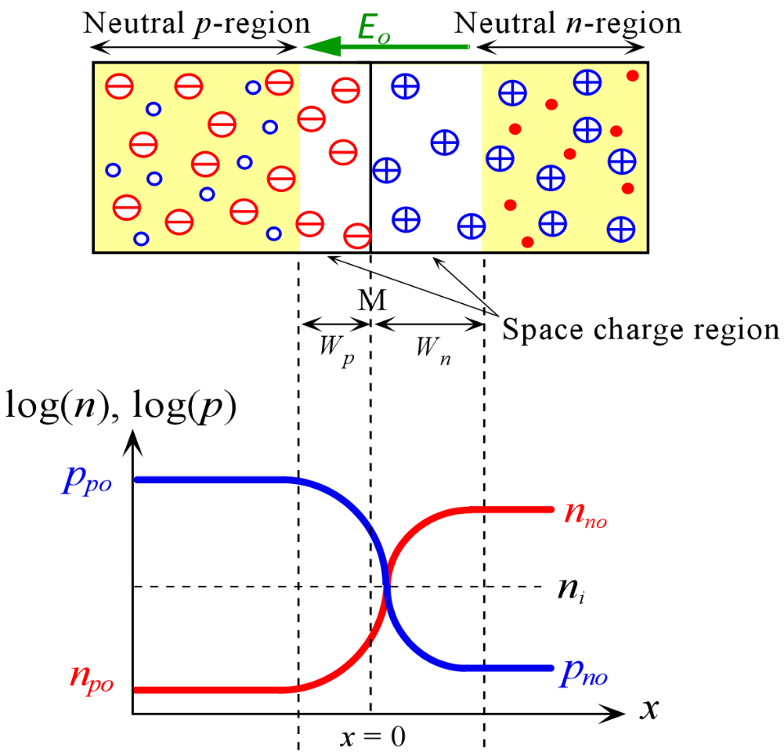
Ideal pn Junction
(b)
(c)

Slide 40
Short Diode
x'
Minority carrier injection and diffusion in a short diode.

Slide 41
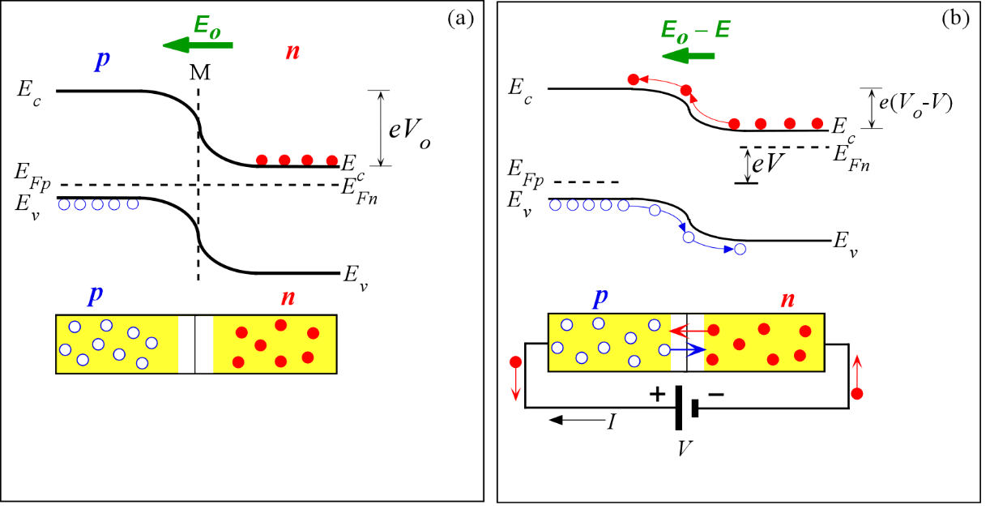
pn Junction Band Diagram: Forward Bias
Energy band diagrams for a pn junction under (a) open circuit and (b) forward bias

Slide 42
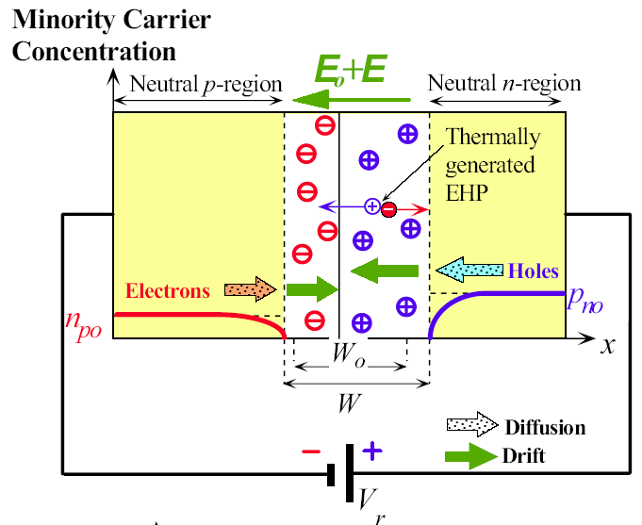
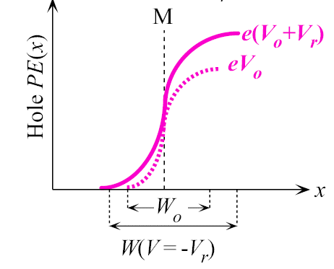
Reverse Bias
(a)
(b)
Reverse biased pn junction. (a) Minority carrier profiles and the origin of the reverse current. (b) Hole PE across the junction under reverse bias

Slide 43
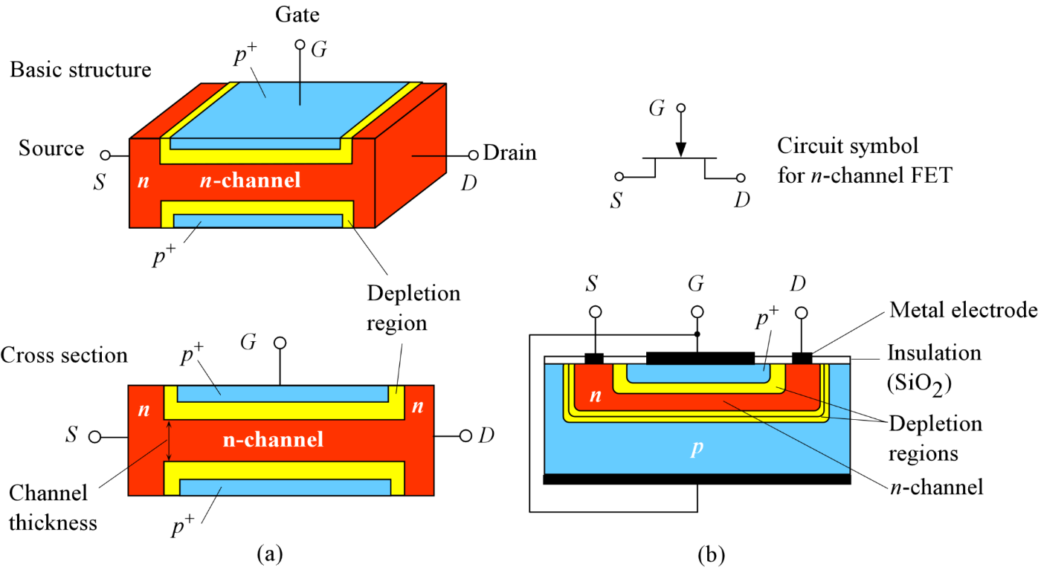
Junction Field Effect Transistor (JFET)
The basic structure of the junction field effect transistor (JFET) with an n-channel. The two p⁺ regions are electrically connected and form the gate.
A simplified sketch of the cross section of a more practical n-channel JFET

Slide 44
Enhancement MOSFET
Below threshold V_{GS} < V_{th} and V_{DS} > 0
Above threshold V_{GS} > V_{th} and V_{DS} < V_{DS(sat)}

Slide 45
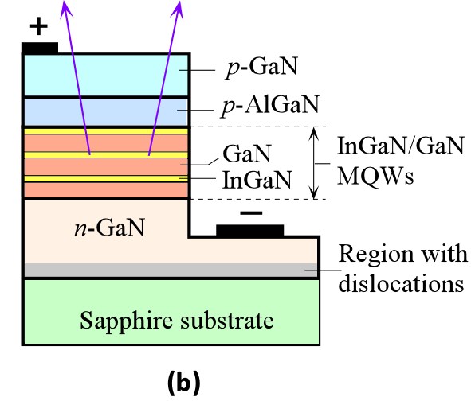
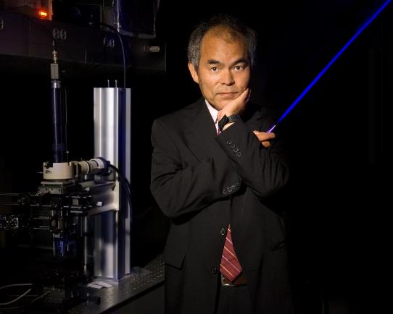
III-Nitride LEDs
Shuji Nakamura, obtained his PhD from the University of Tokushima in Japan, and is currently a Professor at the University of California at Santa Barbara and the Director of Solid State Lighting and Energy Center. He shared the 2014 Nobel prize with Isamu Akasaki and Hiroshi Amano “for the invention of efficient blue light-emitting diodes which has enabled bright and energy-saving white light sources.” He is holding a blue laser diode that is turned on. Courtesy of Randy Lam, University of California, Santa Barbara.
Multiple quantum well III-Nitride based LED

Slide 46

Solar Cells
This is Solar Impulse, a plane powered by solar cells.
Courtesy of Solar Impulse SA, Switzerland
Solar cell inventors at Bell Labs (left to right): Gerald Pearson, Daryl Chapin, and Calvin Fuller. They are checking a Si solar cell sample for the amount of voltage produced (1954).
© Nokia Corporation.

Slide 47
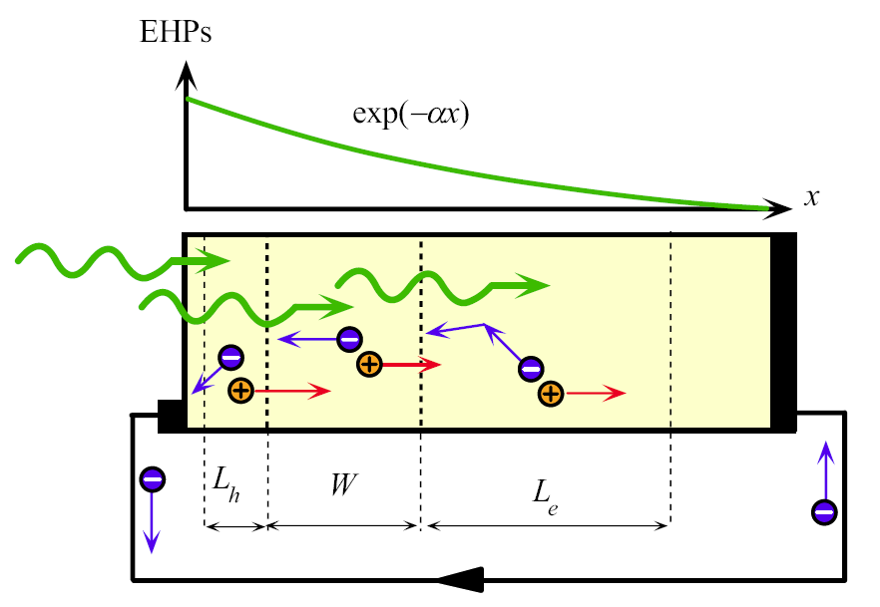
Useful Photogeneration Volume is L_{h} + W + L_{e}
I_{ph}
An np junction solar cell in short circuit. Photogenerated carriers within the volume L_{h} + W + L_{e} give rise to a photocurrent I_{ph}. The variation in the photogenerated EHP concentration with distance is also shown where α is the absorption coefficient at the wavelength of interest.

Slide 48
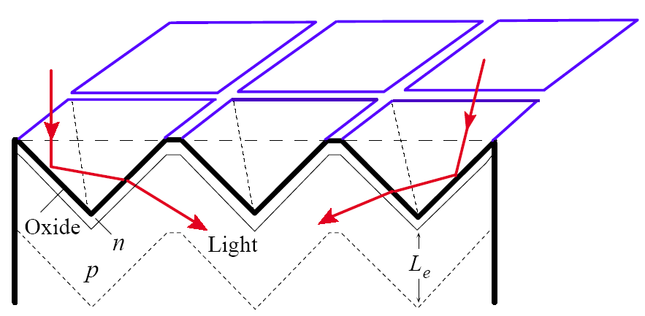
An inverted pyramid textured surface
An inverted pyramid textured surface substantially reduces reflection losses and increases absorption probability in the device.

Slide 49
Enhancement MOSFET
Above threshold V_{GS} > V_{th} and V_{DS} = V_{DS(sat)}
Above threshold V_{GS} > V_{th} and V_{DS} > V_{DS(sat)}

Slide 50
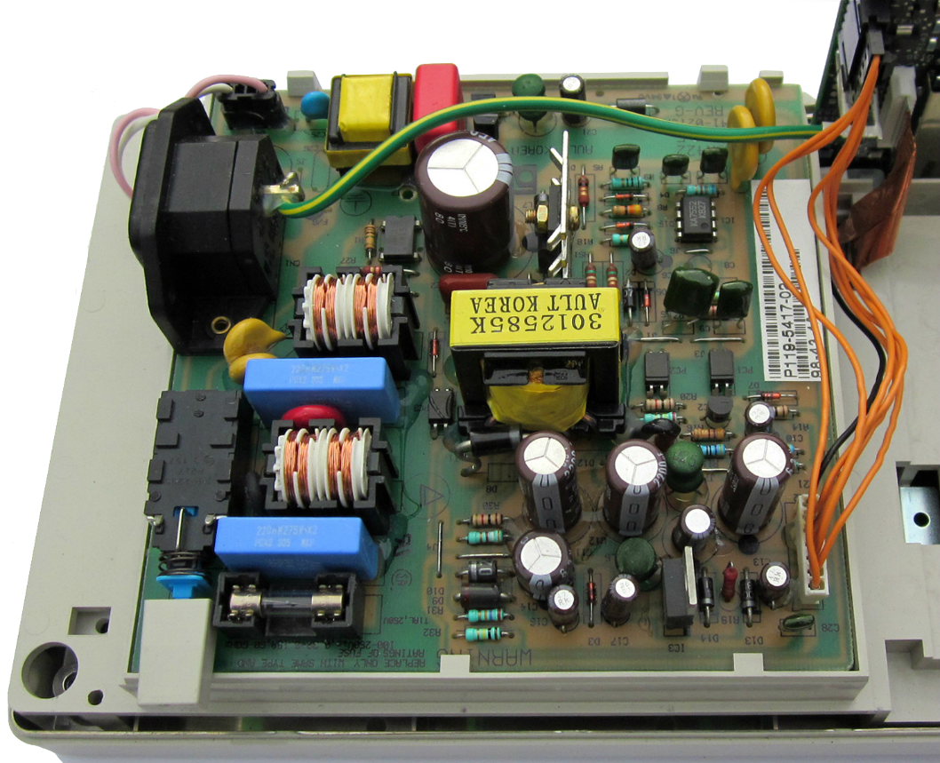
Electrolytic
Polypropylene
Ceramic
Polypropylene
Polyester
Electrolytic

Slide 51
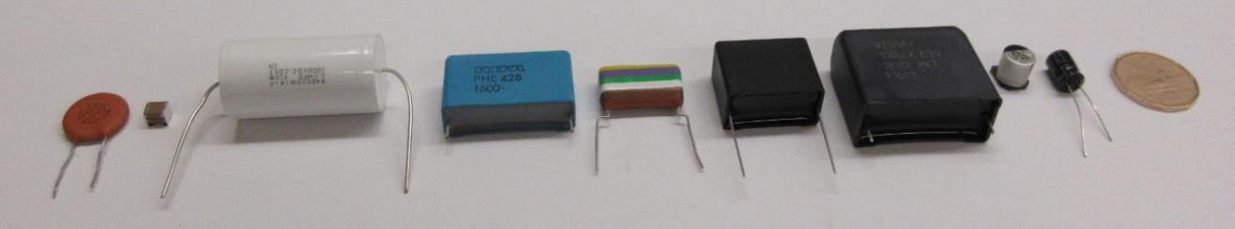


Ceramic
Polypropylene
Polypropylene
Ceramic
Polyester
Polyester
Polyester
Electrolytic
Capacitors with energy in the range 100 to 300 mJ
Polyester
Mica
Tantalum
Ceramic
Polypropylene
Capacitors with energy in the range 0.8 mJ to 2 mJ
0.22 F
5.5 V
0.047 F
5.5 V
0.022 F
5.5 V
1 F
6.3 V
50 F
2.7 V
4.7 F
2.5 V
350 F
2.7 V
All photos by S. Kasap, 2016
Supercapacitors with energy in the range to 0.3 J to 1.27 kJ

Slide 52

A Dielectric Inserted into a Capacitor
(a) Parallel plate capacitor with free space between the plates.
(b) As a slab of insulating material is inserted between the plates, there is an external current
flow indicating that more charge is stored on the plates.
(c) The capacitance has been increased due to the insertion of a medium between the plates.

Slide 53
The Origin of Electronic Polarization
β = Restoring force constant
Electronic polarization resonance frequency
Classical electronic polarizability
Atomic radius

Slide 54
Frequency Dependence of Dielectric Properties
Relaxation
Resonance
The frequency dependence of the real and imaginary parts of the dielectric constant in the
presence of interfacial, orientational, ionic, and, electronic polarization mechanisms.

Slide 55
Debye Equations

Slide 56

Electrical Treeing Breakdown in a High Voltage Coaxial
A schematic illustration of electrical treeing breakdown in a high voltage coaxial cable which was initiated by a partial discharge in the void at the inner conductor - dielectric interface.
A schematic diagram of a typical high voltage coaxial cable with semiconducting polymer layers around the inner conductor and around the outer surface of the dielectric.

Slide 57
Electrical Branch Trees in Dielectric Breakdown
Left: An electric tree spreading from a needle electrode to the counter electrode in cross-linked polyethylene (XLPE) insulation under an ac voltage of 11 kV (rms) after 20 minutes of voltage application. These types of open tree-like structures are usually called branch trees. Notice that a tree brunch just reaches the counter electrode. Right: About 20 seconds later, a dielectric breakdown ensues with a large discharge current along a thick (about 0.1 mm thick) conducting channel (black).
Courtesy of Xiangrong Chen, Xi’an Jiaotong University, China.

Slide 58

Super vs Electrolytic Capacitors
Maximum energy stored in Joules
350 F, 2.7 V
1,275 J
5,500 mF, 350 V
336 J
50 F, 2.7 V
182 J

Slide 59


Piezoelectric Effect
The piezoelectric effect.
(a) A piezoelectric crystal with no applied stress or field.
(b) The crystal is strained by an applied force that induces polarization in the crystal and generates surface charges.
(c) An applied field causes the crystal to become strained. In this case the field compresses the crystal.
(d) The strain changes direction with the applied field and now the crystal is extended.

Slide 60

Dielectric Mixtures
And Heterogeneous Media
Heterogeneous dielectric media examples
Dispersed dielectric spheres in a dielectric matrix.
A heterogeneous medium with two distinct phases I and II.
Series mixture rule.
Parallel mixture rule.

Slide 61

Ampere’s Law
Ampere’s circuital law

Slide 62
Ferromagnetic Materials
In a magnetized region of a ferromagnetic material such as iron all the magnetic moments
are spontaneously aligned in the same direction.
There is a strong magnetization vector M
even in the absence of an applied field

Slide 63


Inductors use soft magnetic materials
0.01 mH
(3 Ω)
0.3 mH (0.41 Ω)
0.51 mH (6.5 Ω)
12.5 mH (14 Ω)
10 mH (23.2 Ω)
L (r)
Photo by SK
Resistance, r
Inductance, L
Resistance of windings and ferrite losses
Simplest equivalent circuit with losses

Slide 64



Rare-Earth Magnets
Rare-earth magnet based DC motor.
Courtesy of Maxon Precision Motors, Inc.
Neodymium magnet based speakers.
Courtesy of Eminence Speaker, LLC.
Neodymium magnet based earphones
Photo by S. Kasap

Slide 65


Pauli Spin Paramagnetism
Pauli spin paramagnetism in metals due to conduction electrons

Slide 66

Giant Magnetoresistance (GMR)
A highly simplified view of the principle of the giant mangetoresistance effect.
The basic trilayer structure.
Antiparallel magnetic layers with high resistance R_{AP}.
An external field aligns layers, parallel alignment has a lower resistance R_{P}.

Slide 67


A permanent magnet with a small air gap
Magnet with air gap. Point P is the operating point of the magnet and determines the field inside the magnet and in the air gap, that is B_{g}'. The corresponding magnetizing field is H_{m}'
Energy density in the gap is proportional to BH, and for a given geometry and size of gap, this is a maximum at a particular magnetic field B_{m}* or B_{g}*

Slide 68
Definitions in Magnetic Data Storage
A simplified view of longitudinal recording track with magnetized crystalline grains in a track. σ is the rms variation in the position of the boundary between two neighboring bits.
The definitions of λ, w and t involved in a bit-track with a magnetized one-bit volume in gray.
Transmission electron microscope image of a granular magnetic thin film medium for high density storage.

Slide 69

Type I and Type II superconductors
Characteristics of Type I and Type II superconductors. B = µ_{o}H is the
applied field and M is the overall magnetization of the sample. Field inside the sample,
B_{inside} = µ_{o}H + µ_{o}M, which is zero only for B < B_{c} (Type I) and B < B_{c1} (Type II).

Slide 70

A high temperature superconductor (HTS) power cable
Liquid N₂
Hollow former
HTS
Dielectric
HTS
Liquid N₂
Dielectric
HTS
Dielectric
Copper screen
Inner cryostat wall
Insulation
A high temperature superconductor (HTS) power cable for use at 10 kV and 2,300 A. The HTS is Bi223.. The cable has been installed
in the city center of Essen (Germany) by a German utility company RWE Deutschland; and it has been in use since 2014. The superconductor
shown is manufactured by Nexans.
© Reuters/Alamy Stock Photo

Slide 71

Fresnel's Equations
Light wave traveling in a more dense medium strikes a less dense medium.
The plane of incidence is the plane of the paper and is perpendicular to the flat interface between the two media. The electric field is normal to the direction of propagation. It can be resolved into perpendicular (⊥) and parallel (||) components.

Slide 72

Dielectric mirrors
A dielectric mirror consists of a stack of dielectric layers of alternating refractive indices: n₁|n₂|n₁|n₂|n₁|n₂|n₁|n₂| ….
The thickness of each layer is a quarter of wavelength or λ_{layer}/4 where λ_{layer} is the wavelength of light in that layer or λ_{o}/n where λ_{o} is the free space wavelength at which the mirror is required to reflect the incident light and n is the refractive index of the layer.

Slide 73

Lattice Absorption: Reststrahlen Absorption
Lattice absorption through a crystal. The field in the EM wave oscillates the ions, which consequently generate "mechanical" waves in the crystal; energy is thereby transferred from the wave to lattice vibrations

Slide 74

Optical Activity
An optically active material such as quartz rotates the plane of polarization of the incident wave: The optical field E rotated to E'.
If we reflect the wave back into the material, E' rotates back to E.

Slide 75

Luminescent Emission
Optical absorption generates an electron and hole pair (EHP).
Both carriers thermalize. There are a number of recombination processes via a dopant that can result in a luminescent emission.

Slide 76

The light from an LCD display is linearly polarized
The light from an LCD display is linearly polarized. A number of square polarizers have been placed on the screen of this laptop computer at different angles until the light is totally extinguished. There are five polarizers placed on the screen at different angles.
Photo by S. Kasap

Slide 77
Sample Slides
The End
Email errors and corrections to safa.kasap@yahoo.com

